Slide 1

UI Review & Recommendations
KOKO
Manager/ Admin/ Core

Slide 2

Cheers for what we have achieved, to date!

Slide 3
It’s an analysis of Interface.
To fix something we need to know what is broken.

Slide 4
It’s an analysis of Interface.
We have not looked into the following:
User groups
User task analysis
Expected mental models
Jobs to be done framework
User Journey maps
System dependencies
etc.

Slide 5
Review framework
VIMM System | Design Principle
Visual Optimize visual comprehension by… | Matching screen flow to task flow Good grouping and labeling Careful use of color
Intellect Simplify decision making by… | Providing previews and easy escapes Using controls consistently Providing good system feedback
Memory Minimize the memory load by… | Making options visible Designing for recognition versus recall Providing defaults
Motor Minimize movement time and interactions by… | Using short distances and large targets Optimizing for the input devices Using natural response mappings Reducing windows and steps

Slide 6
Let’s Dig In….

Slide 7
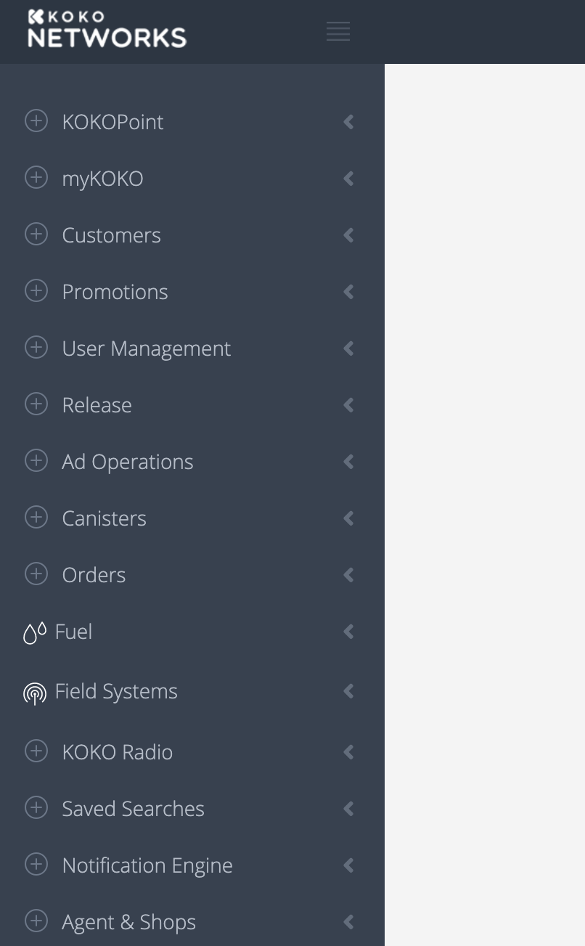
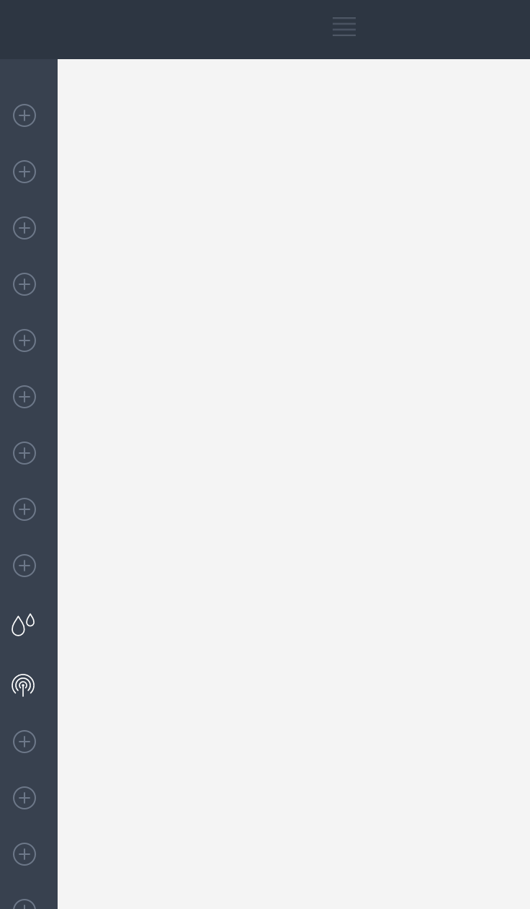
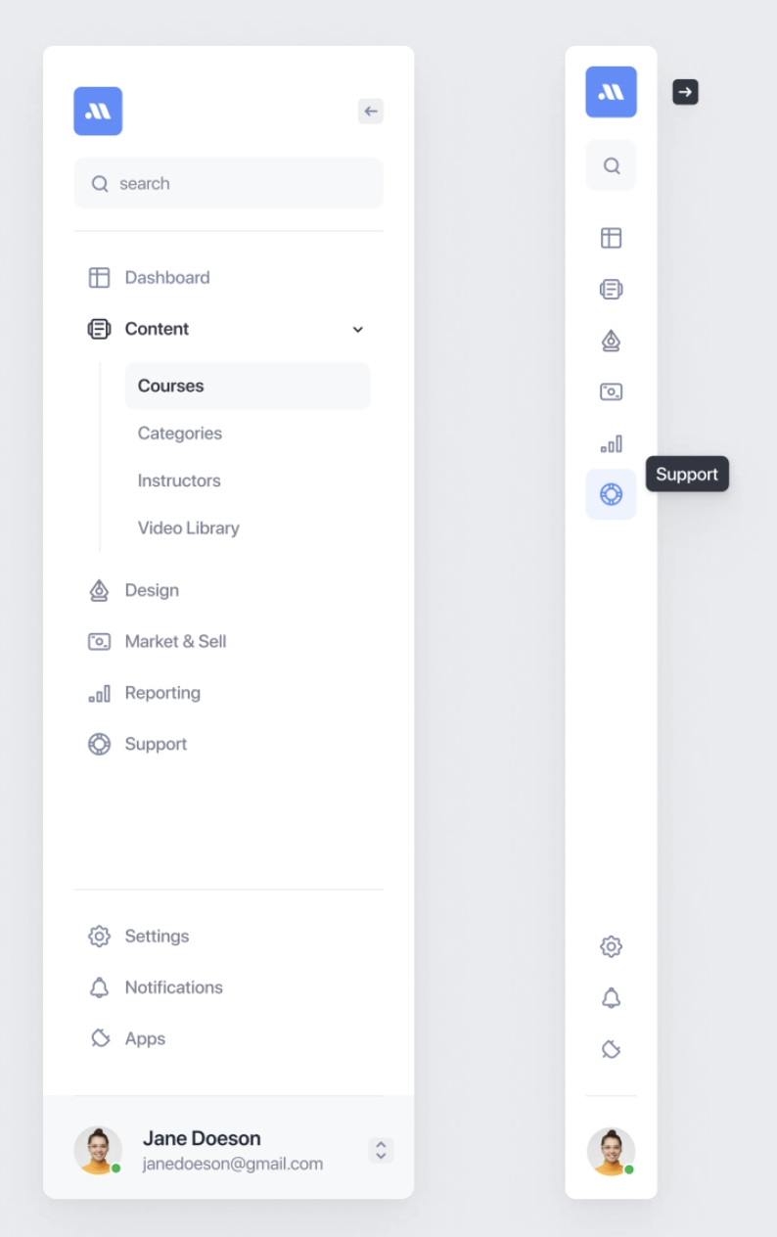

Effects All
Unconventional Menu behaviour
The icons don’t add any cognitive assistance.
Self-descriptive icons to reduce cognitive load.

Slide 8
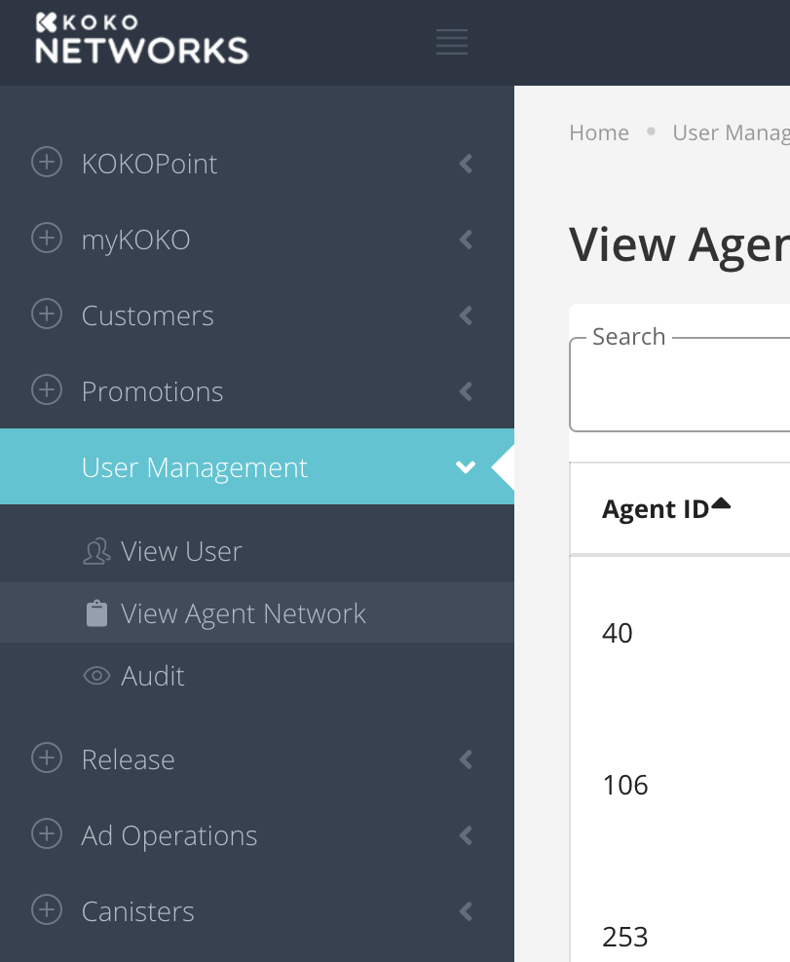
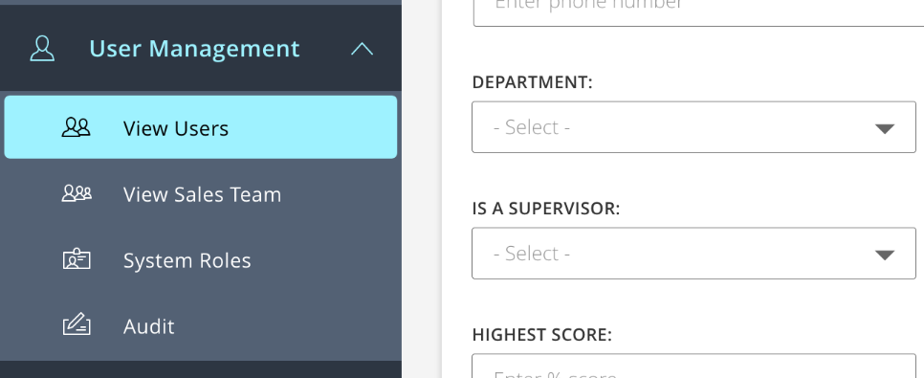
Effects All
Difficult to understand what is selected.
Since the accent color draws attention instantaneously, it feels like ‘User Management’ is selected.
Infact, ‘View Agent Network’ is selected.
The visual hierarchy and use of colors and shapes seems misleading.
Clear sense of ‘where you are’. User feels in control.

Slide 9
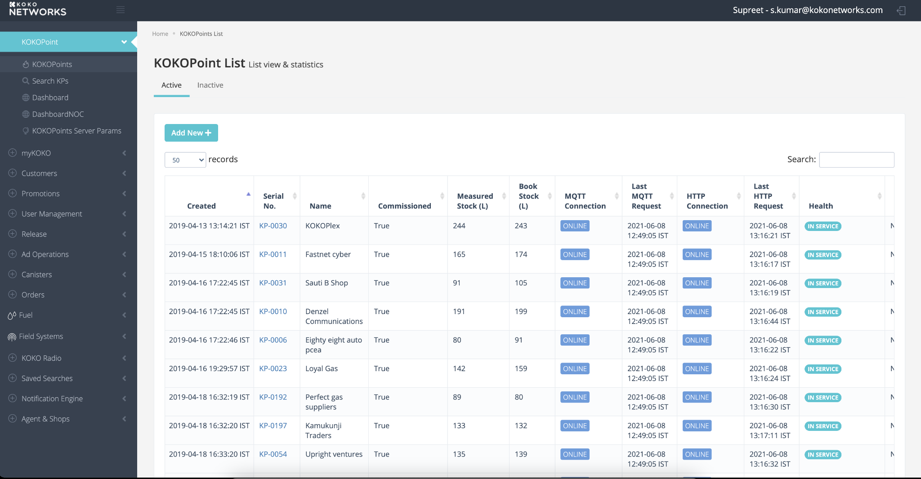
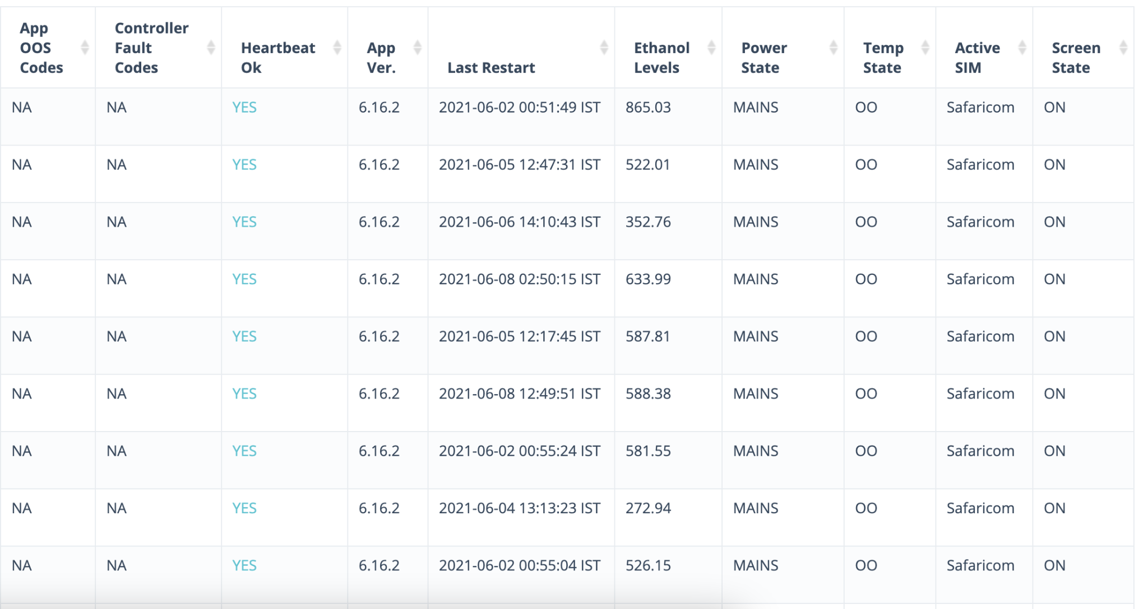
Squad
Need to have visual affordance that more exists on scroll
Clear affordance that ‘more’ content is available on scroll.

Slide 10
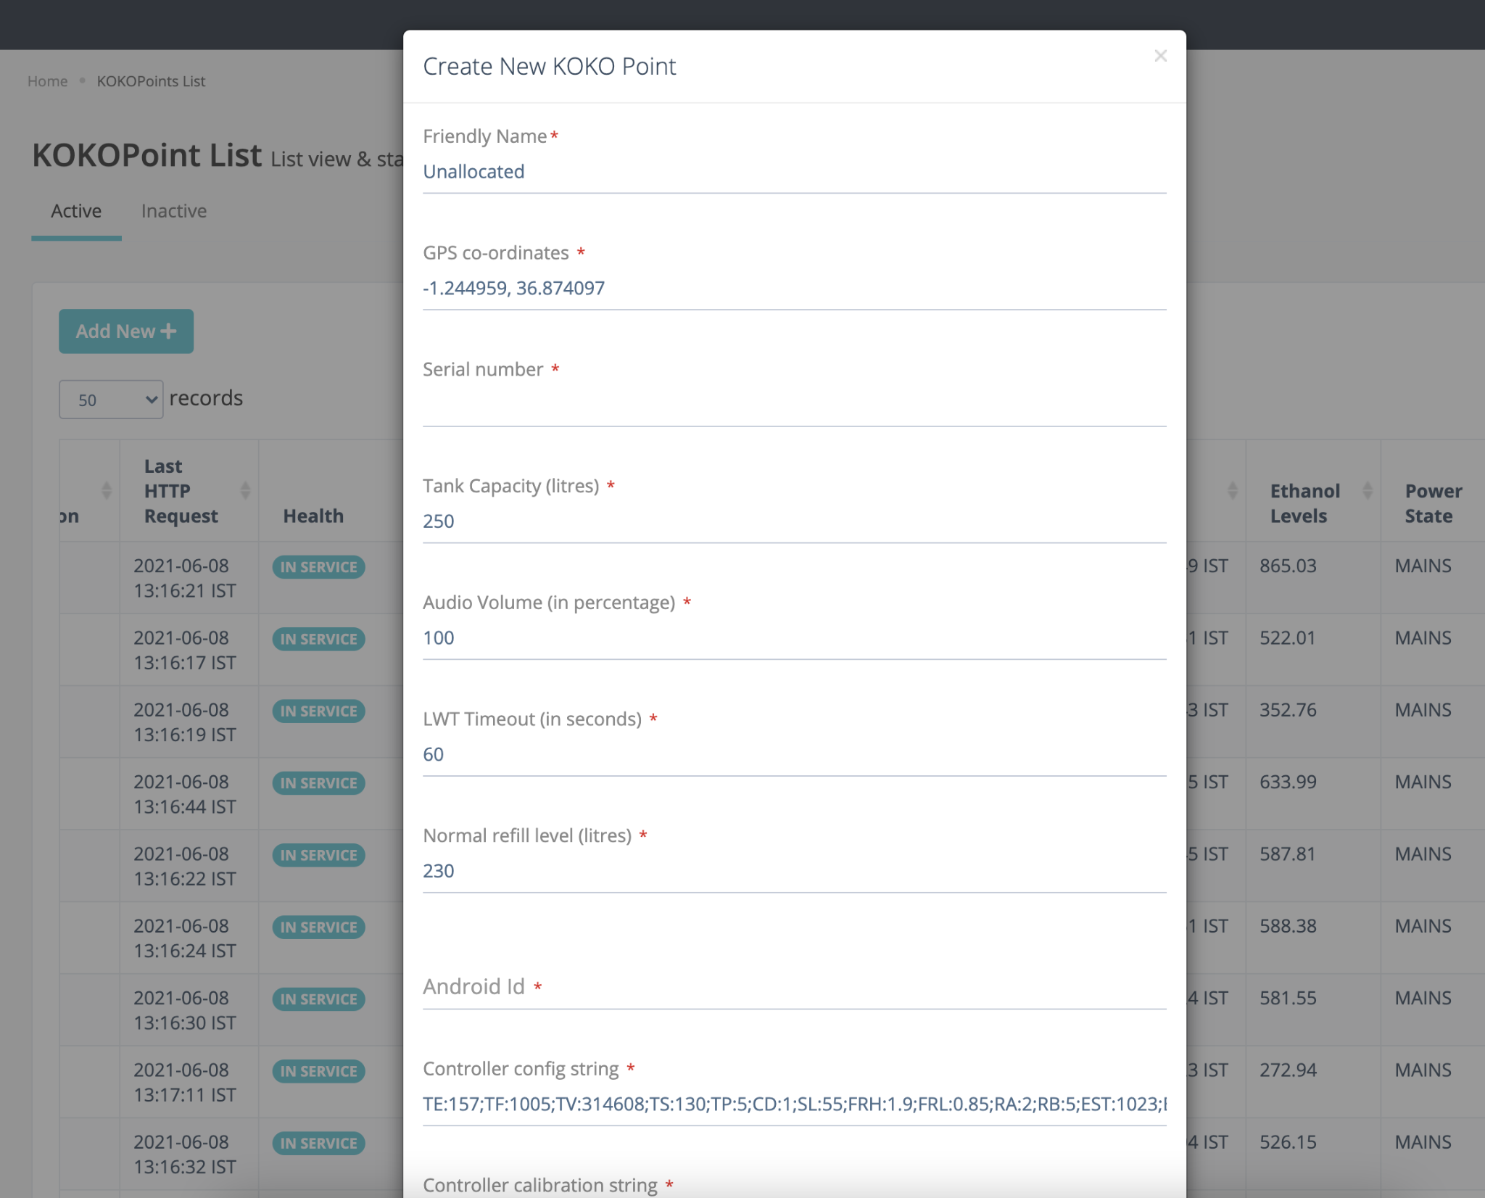
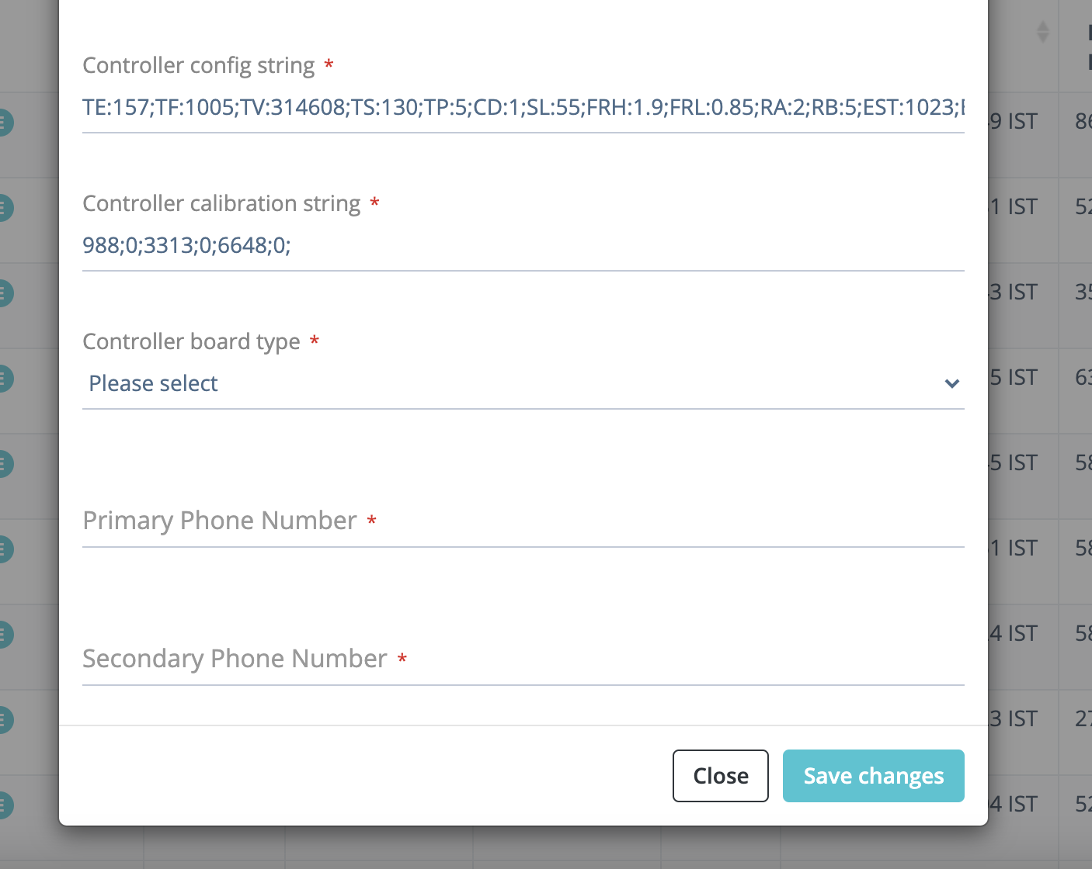
Squad
CTA is below the fold.
This increases motor and cognitive load.
Expose the CTA at all time so there is no chance for the user to miss it. Additionally, s/he does not need effort to discover it

Slide 11
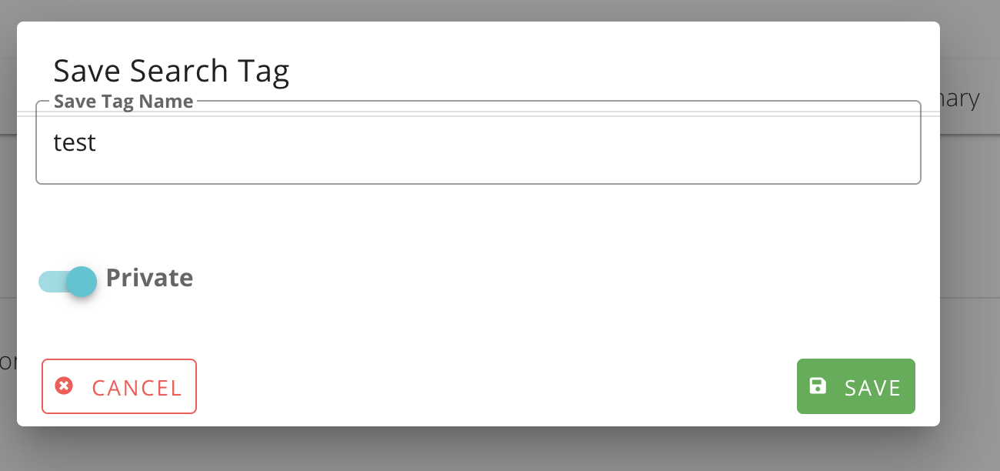
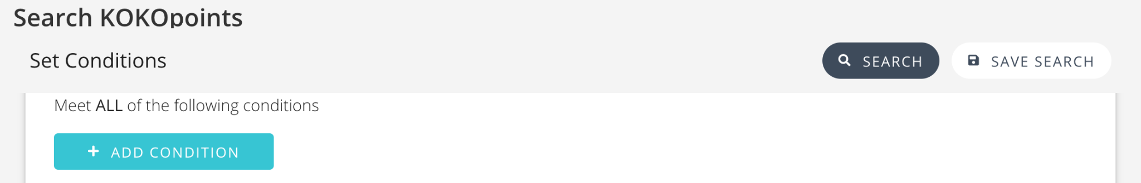
Effects All
In-consistent buttons and placement patterns
Consistent patterns help reinforce a mental model for the users which helps in perception, recognition and expectation.

Slide 12
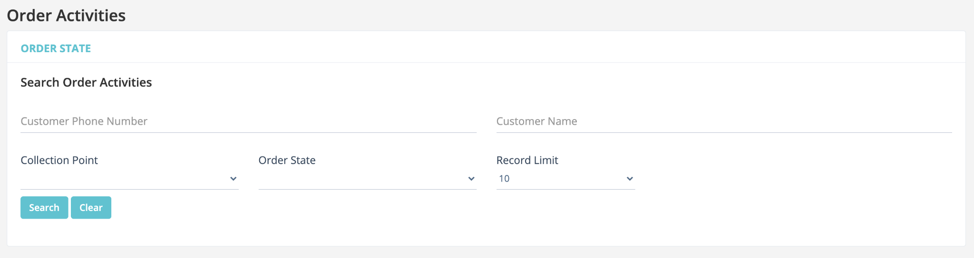
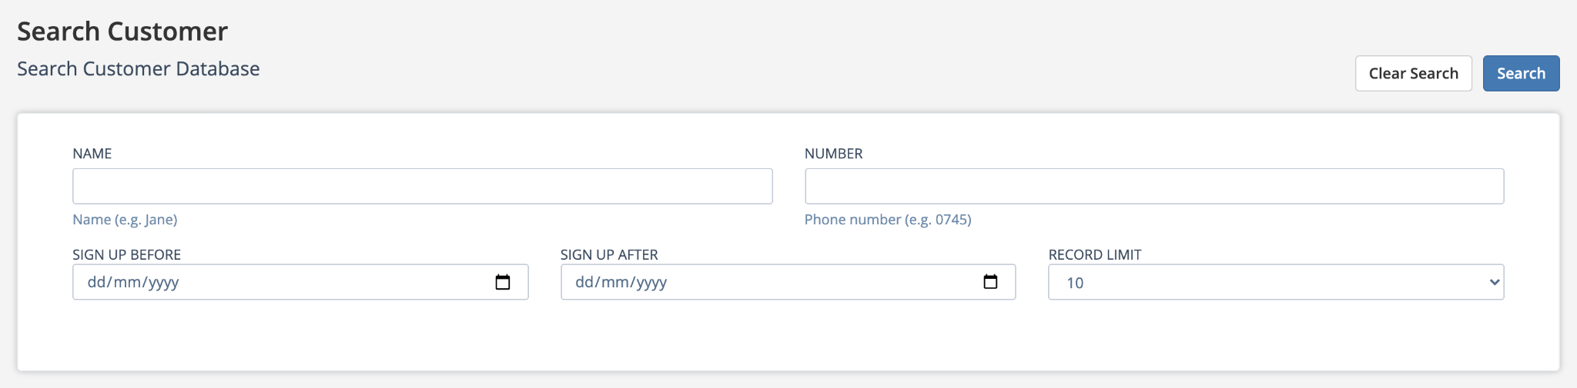
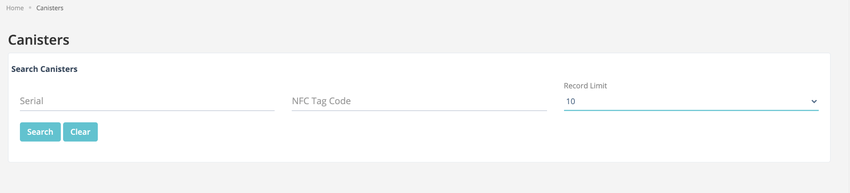
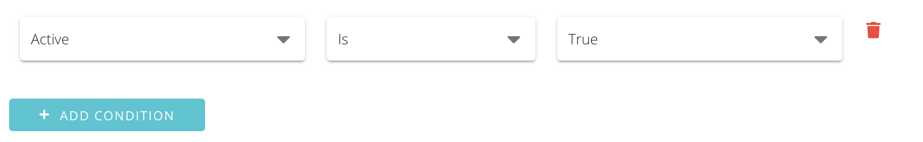
Effects All
Inconsistent Input Fields
Consistent patterns help reinforce a mental model for the users which helps in perception, recognition and expectation.

Slide 13
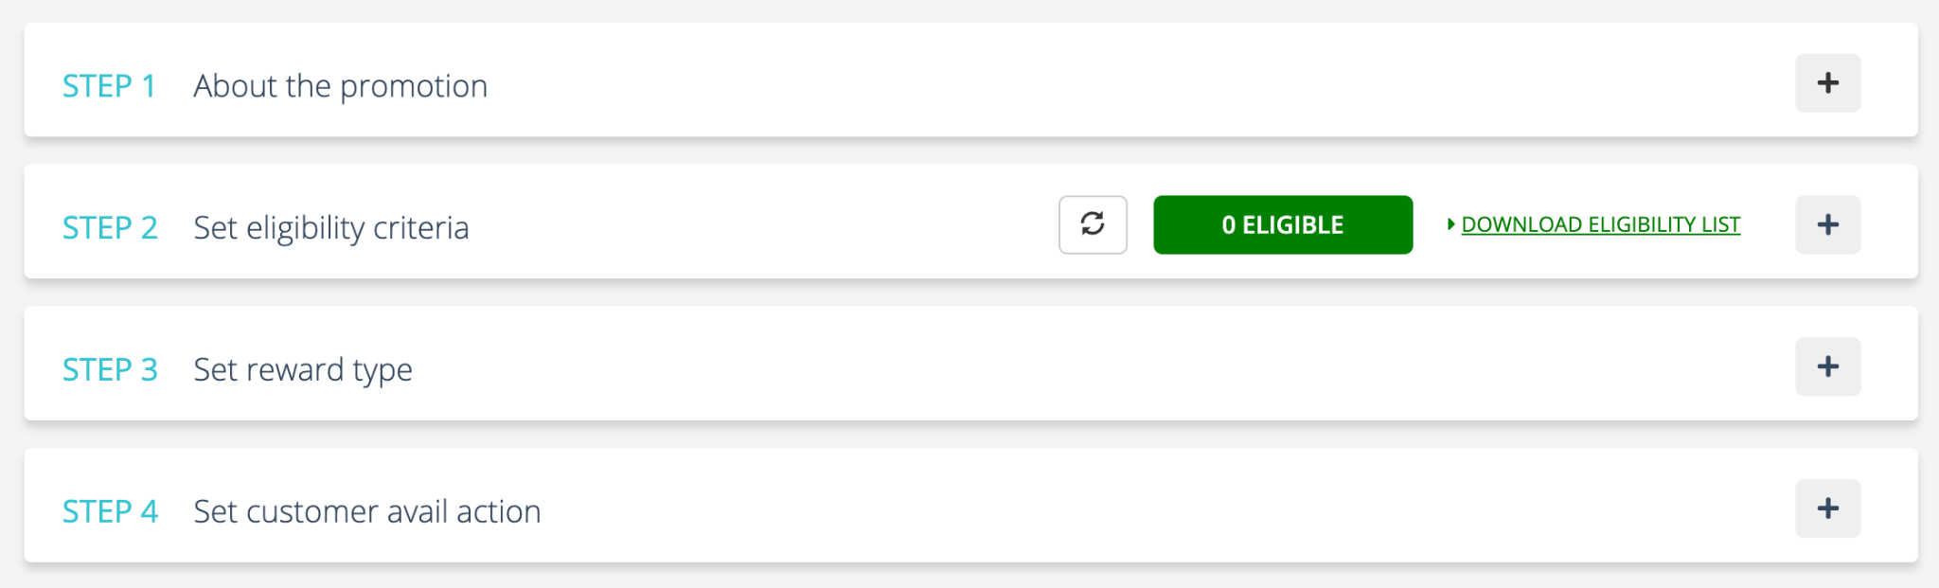
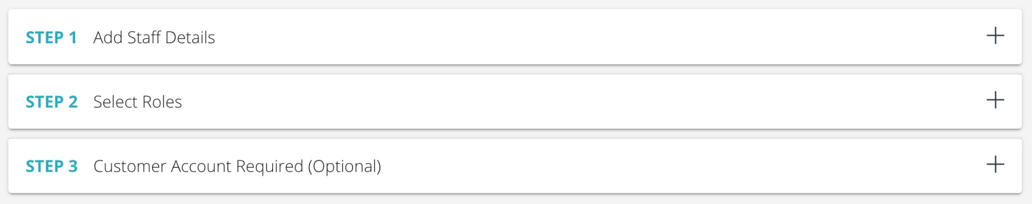
Squad
Inconsistent Interface
Consistency in UI elements and interaction models.

Slide 14
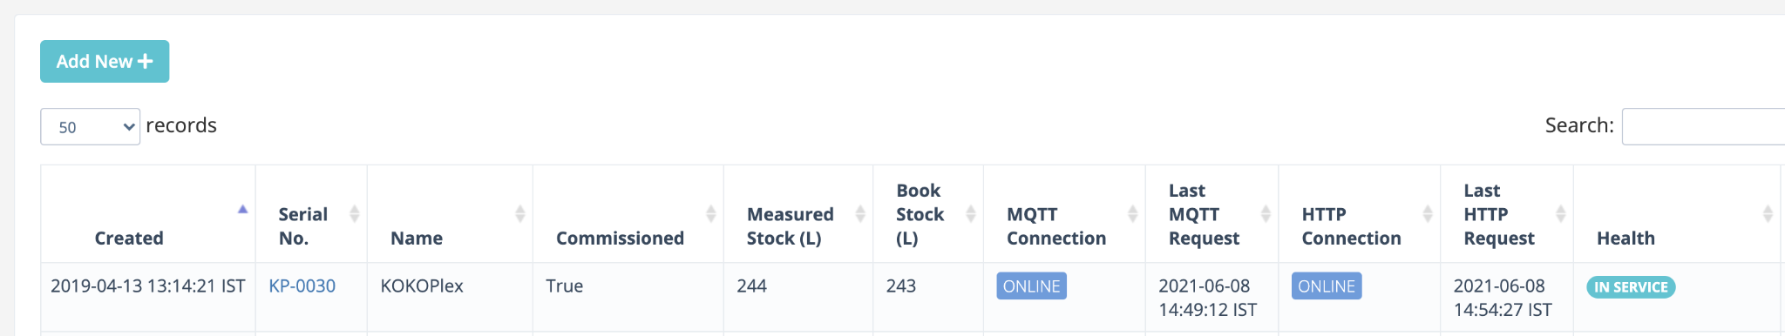
Squad
Inconsistent Affordance
Clickable.
Not Clickable
Inconsistent styling of ‘Status’.
Establish consistent patterns.

Slide 15
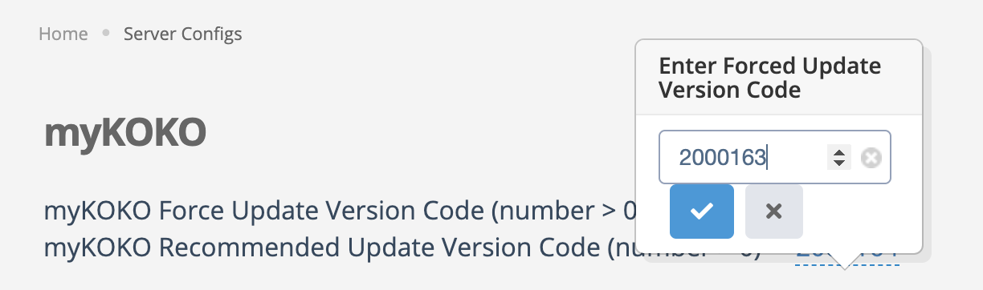
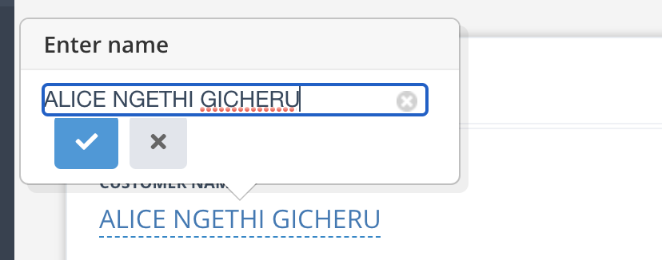
Effects All
Take care per story basis
In-consistent data edit pattern
Establish consistent patterns.

Slide 16
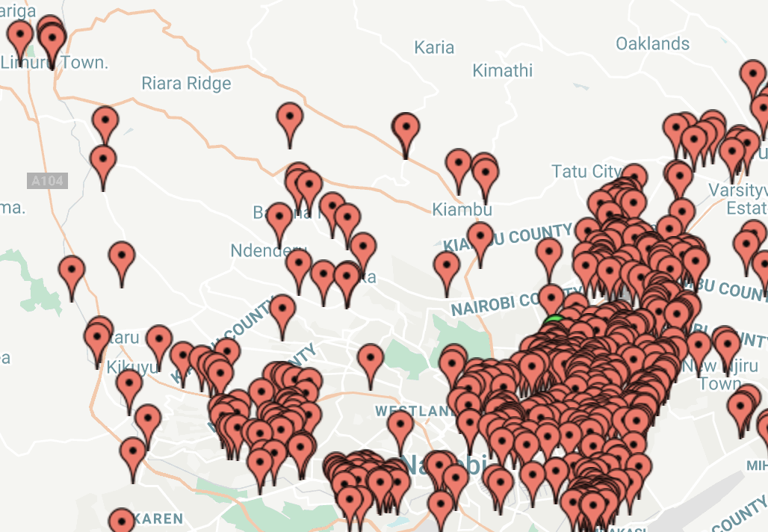
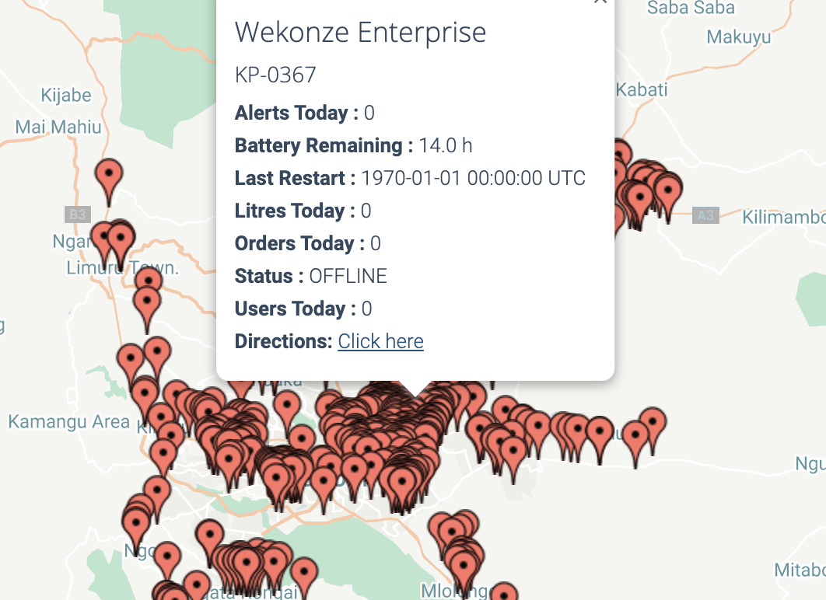
Dead Page
Network - Brian
Field team engineer - Duke
All KP’s are displayed in one go so it’s difficult to look for specific KPs.
Information which you can not reach does not exist.
Introduce a mechanism which helps balance the KPs displayed in accordance to the real-estate on screen.

Slide 17
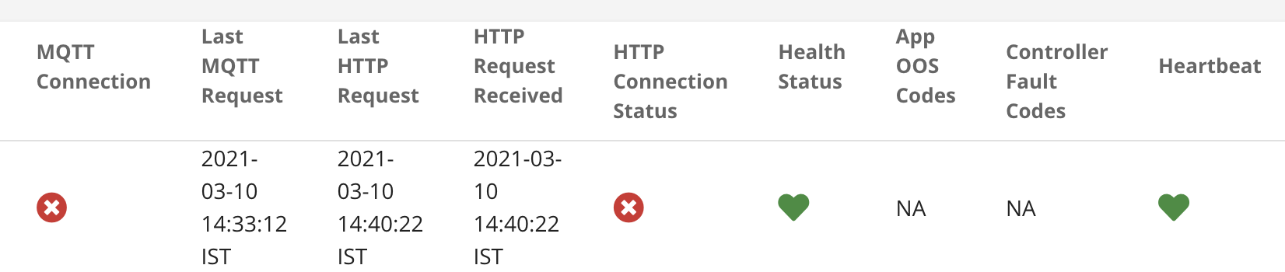
Squad
One icon, multiple usage.
Icons should have unique meanings associated with them to avoid ambiguity and foster recall value.

Slide 18
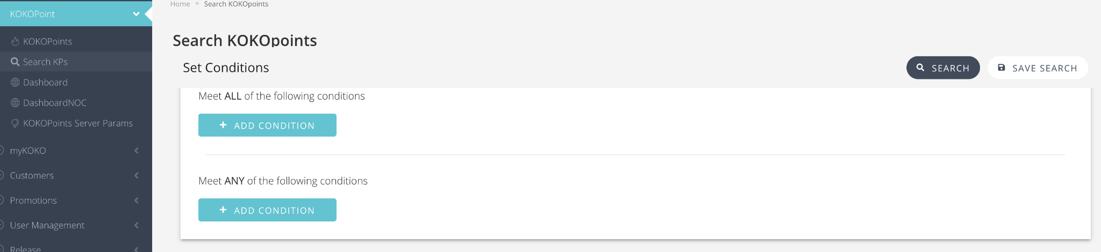
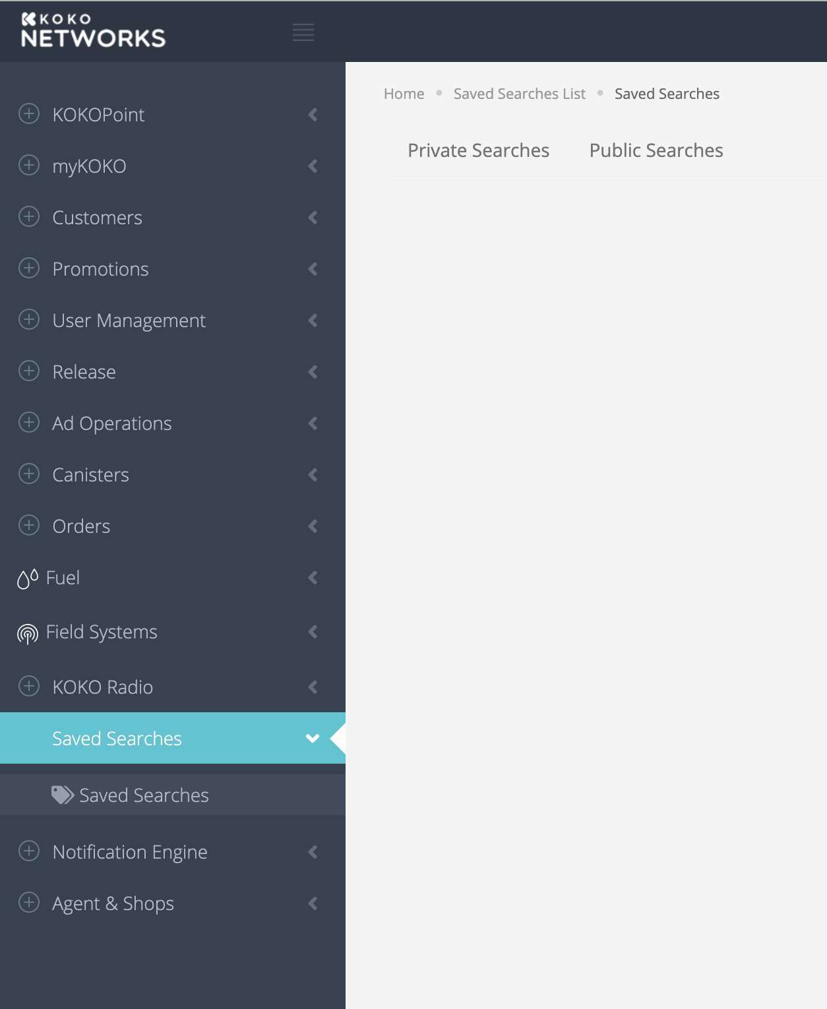
Squad
No way to retrieve Saved search, in fresh session.
Well, it jumps to ‘Saved Searches” out of the blue.
Have related information clustered together.

Slide 19
Squad
Dancing Rows: Increases cognitive load and create spatial delusion
Search must be impacting rows. Don’t see a reason for the columns to be moving around.

Slide 20
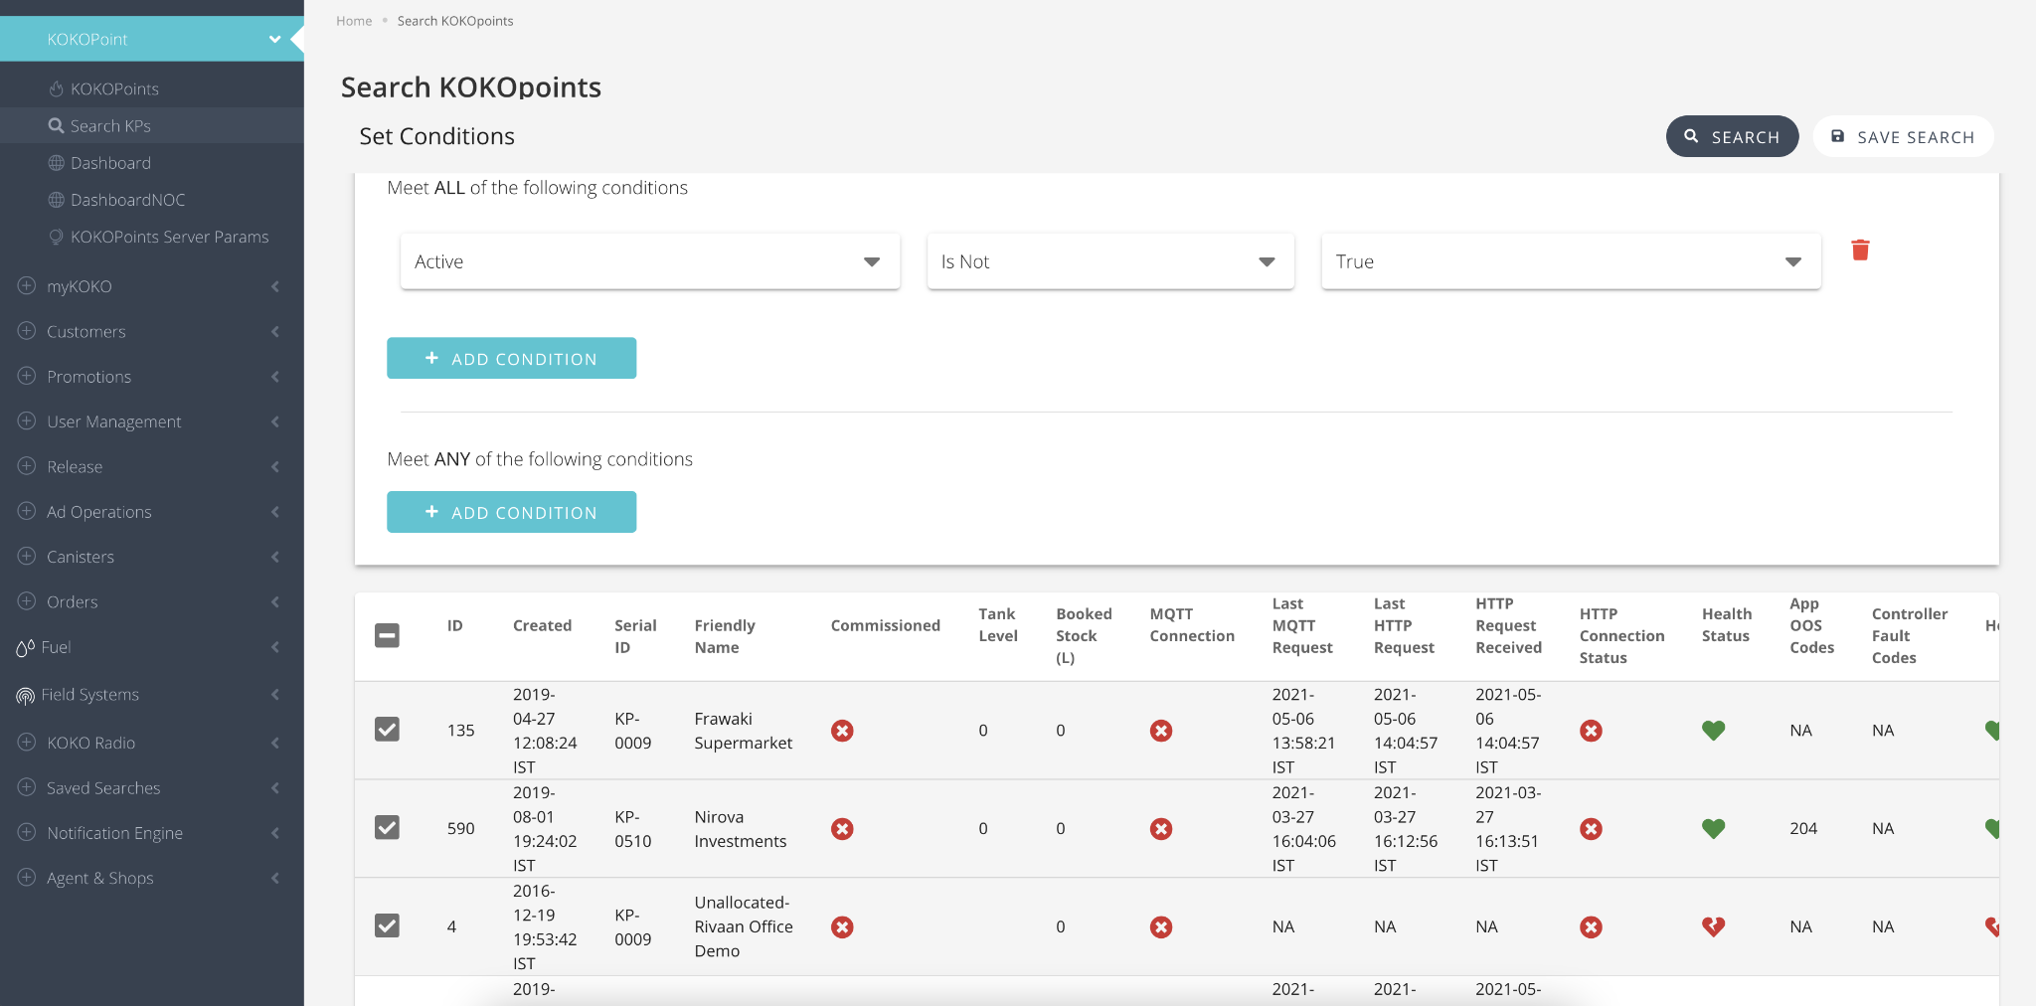
Squad
What to do post selecting?
Unnecessary elements taking up precious real-estate on screen.
Declutter screen by removing unwanted elements.

Slide 21
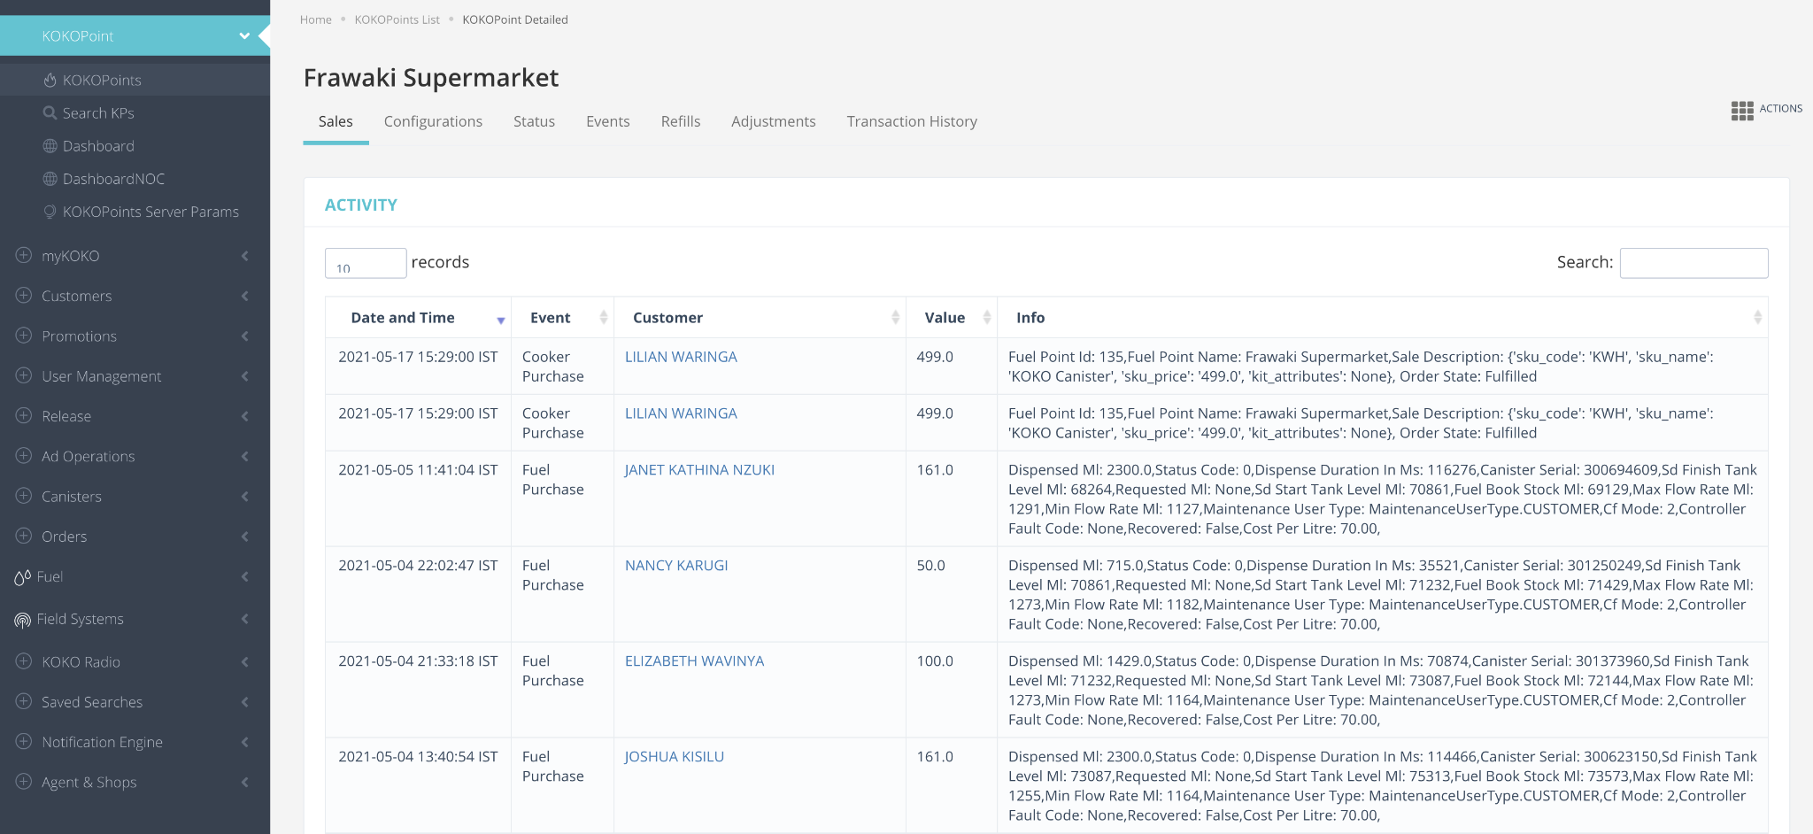
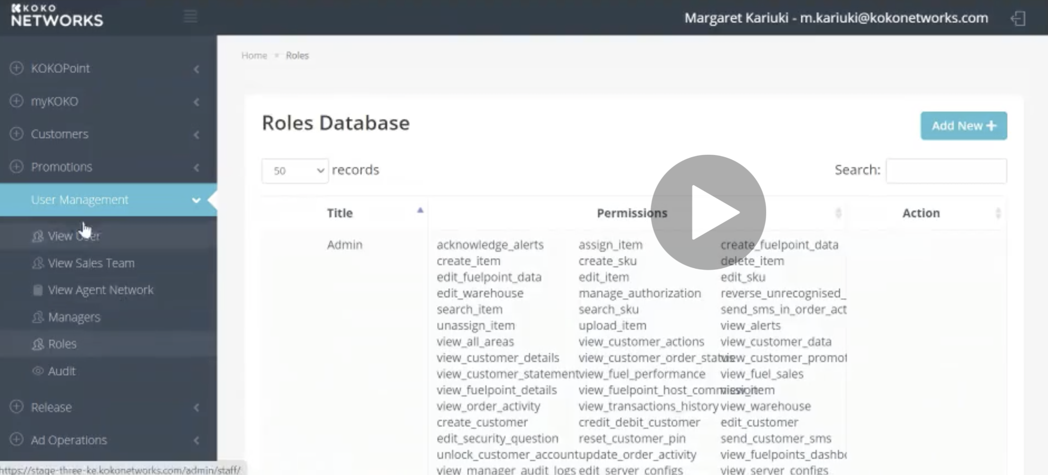
Squad
Too crowded.
Unwanted cognitive load to find relevant information.
Appropriate clean-up and clustering of information required.

Slide 22
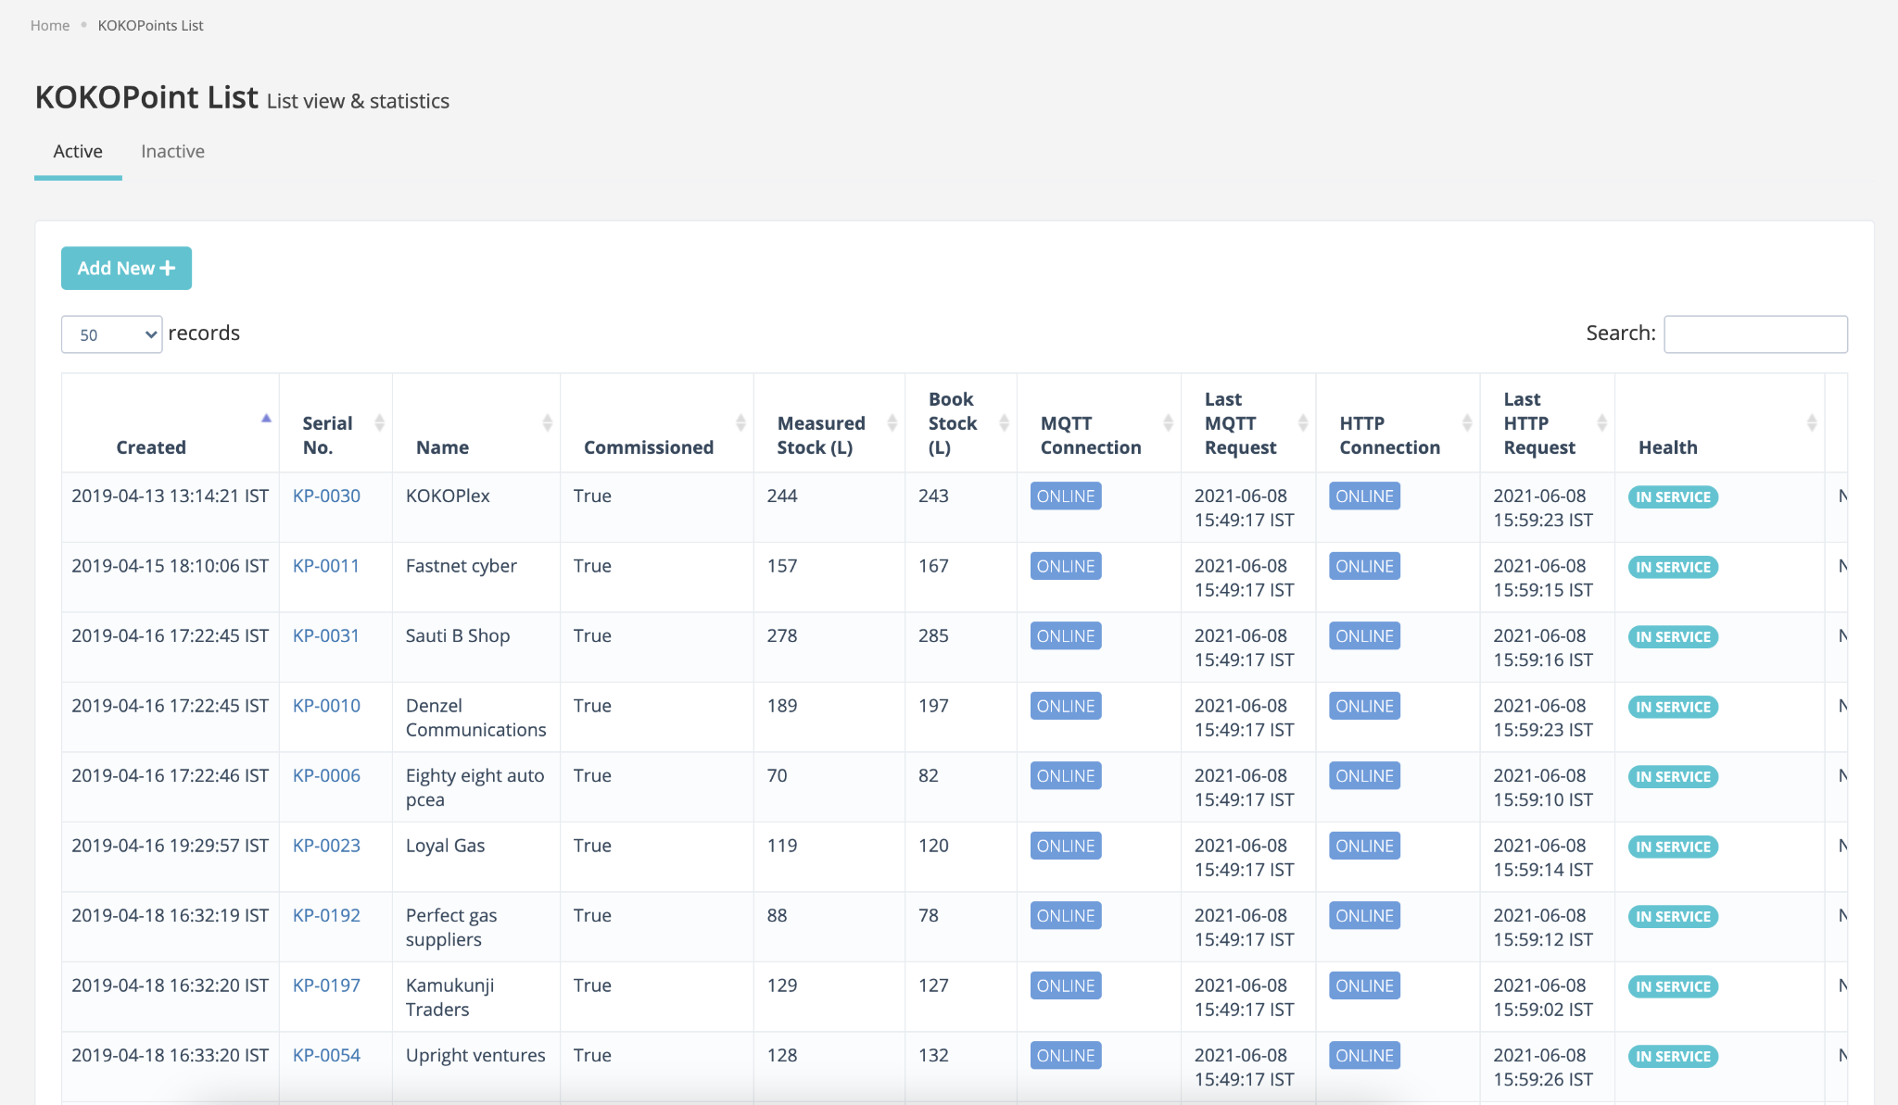
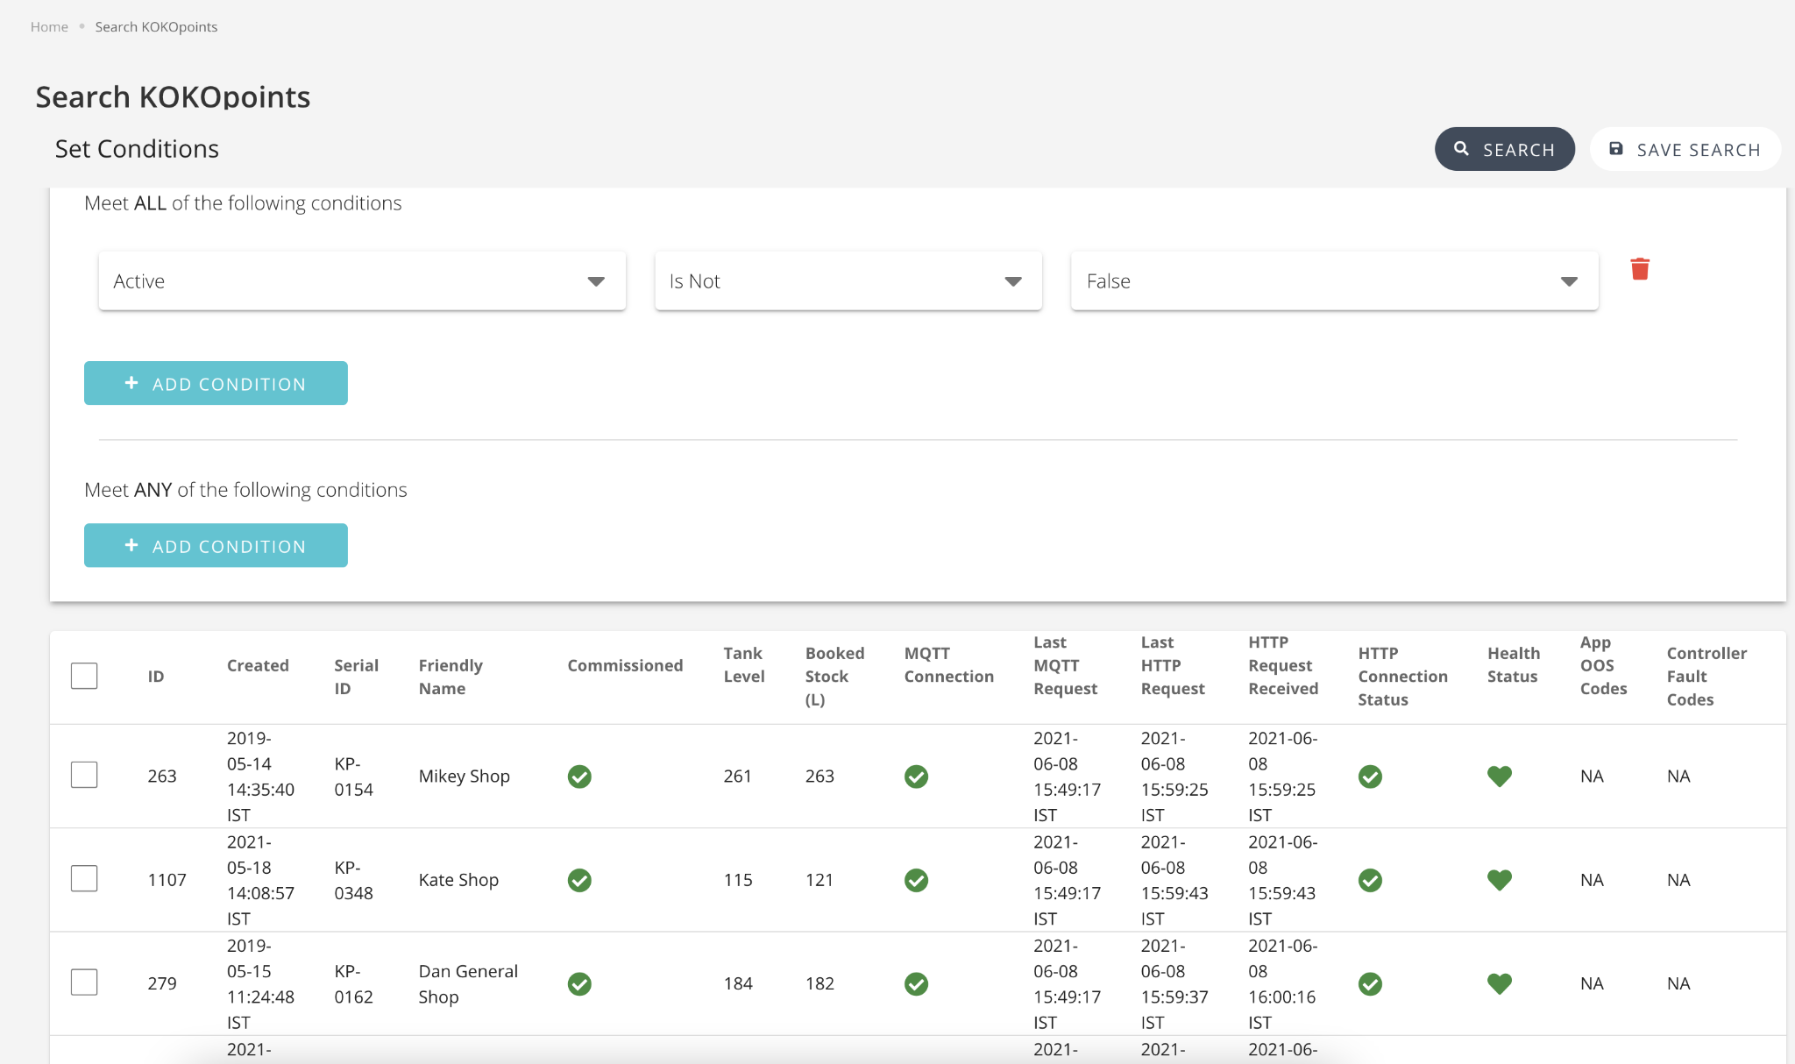
Squad
Believing that the master database to be the same, shouldn’t these 2 pages be combined?
Clustering of related information required.

Slide 23
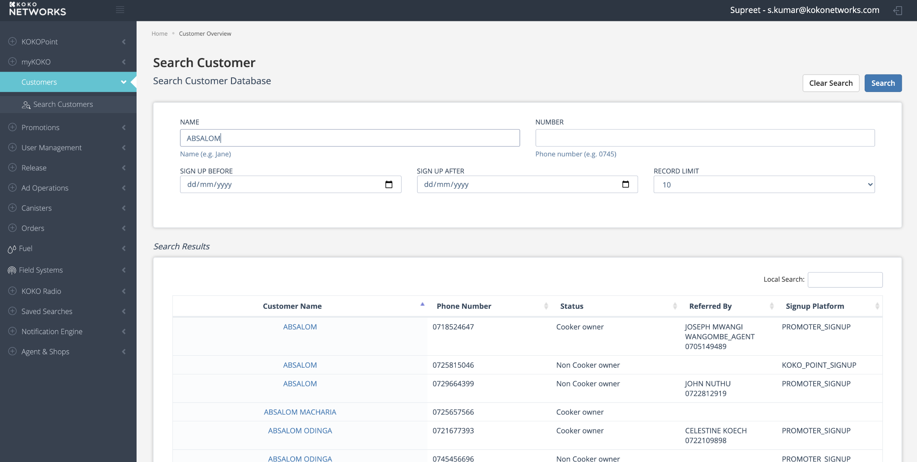
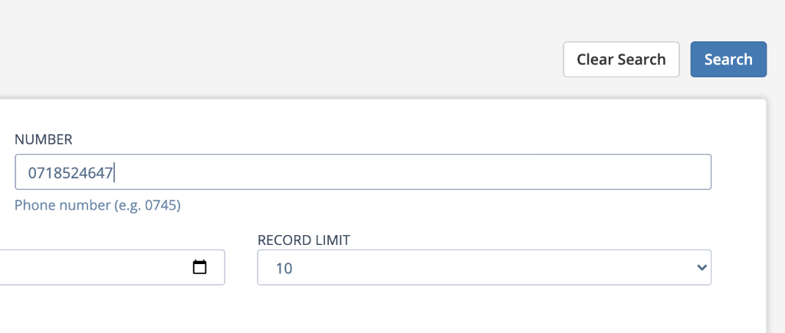
Squad
Auto-complete may help
If it is Phone number, call it phone number
Recognition vs Recall

Slide 24
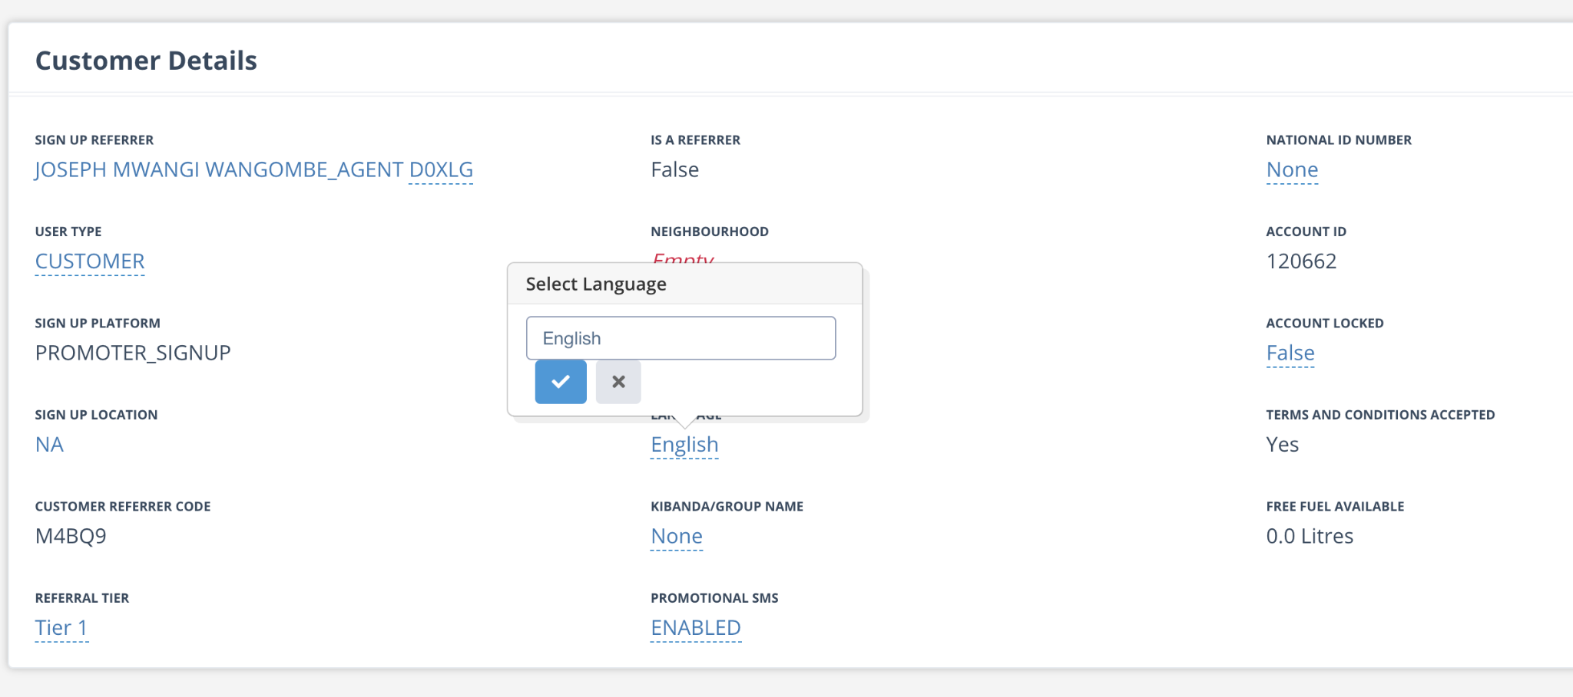
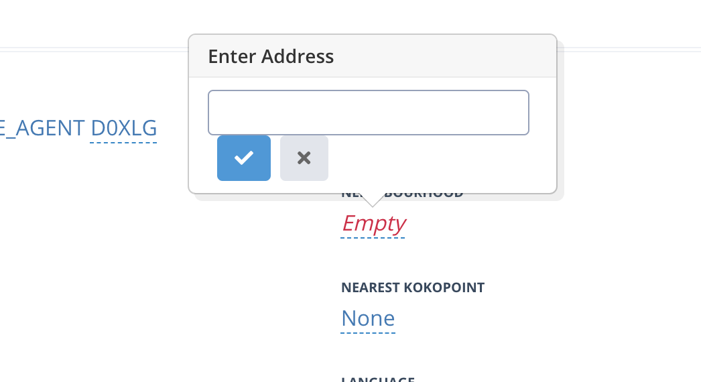
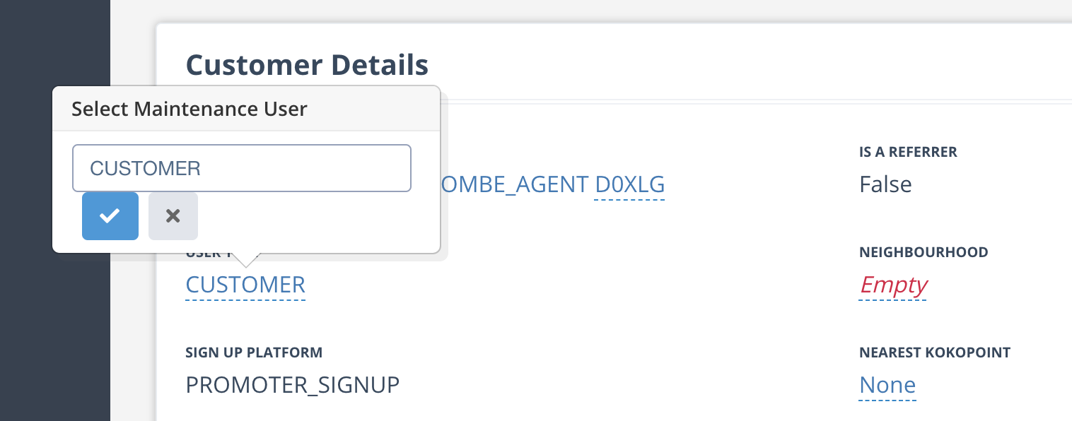
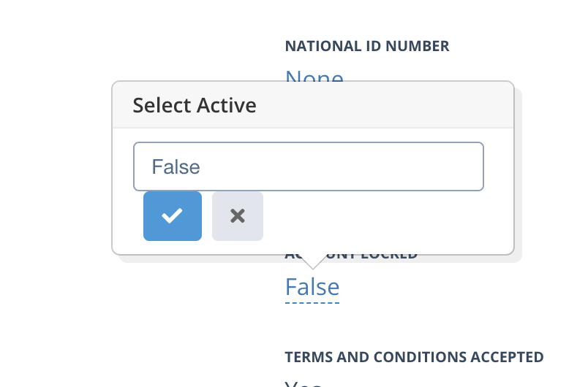
Squad
Input fields, Dropdown binary option … everything looks the same.
Which basically mean they have poor affordance.
I first mistook them for hyperlinks, and was hesitant to click on it.
Dropdown
Input field
Dropdown
Boolean selection
Adequate affordance for individual UI elements.

Slide 25
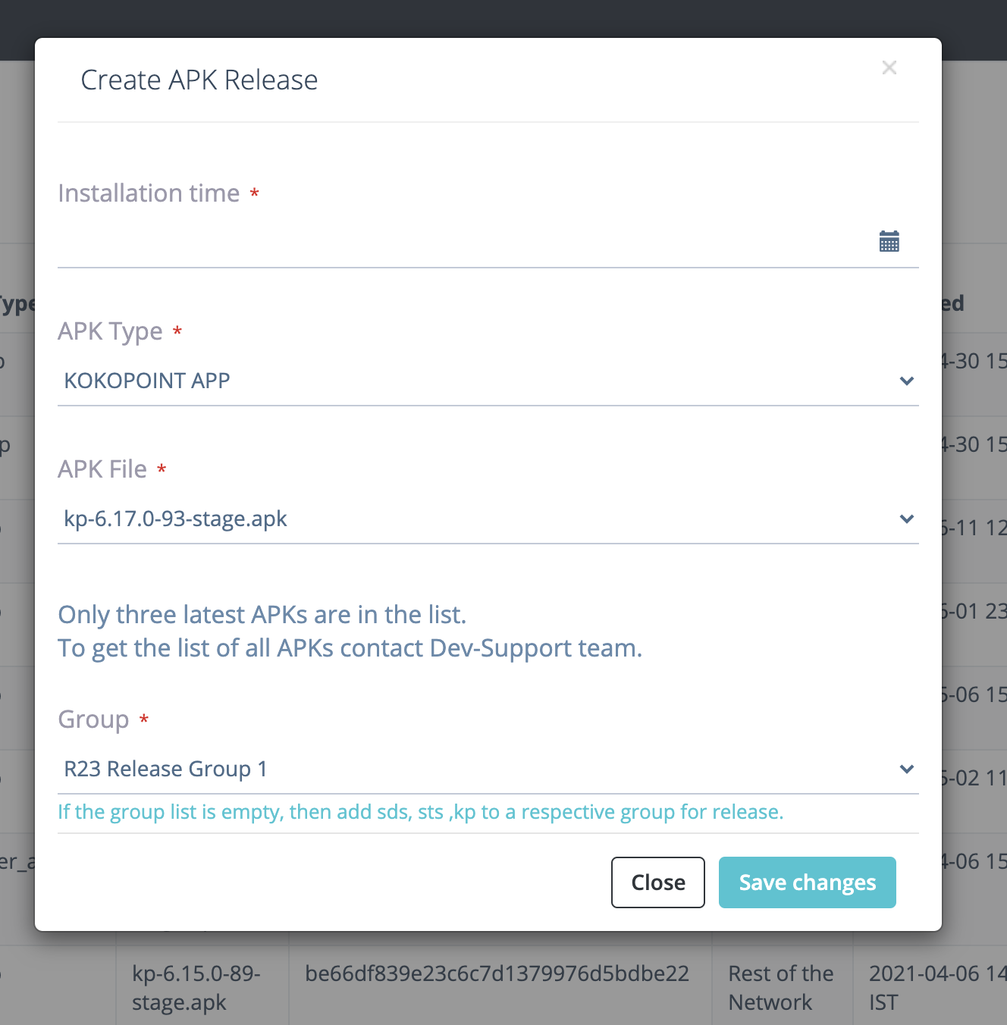
Take care per story basis
Multiple (poor) Alignments
Cleanly aligned elements on the page give impression of reduced visual clutter.

Slide 26
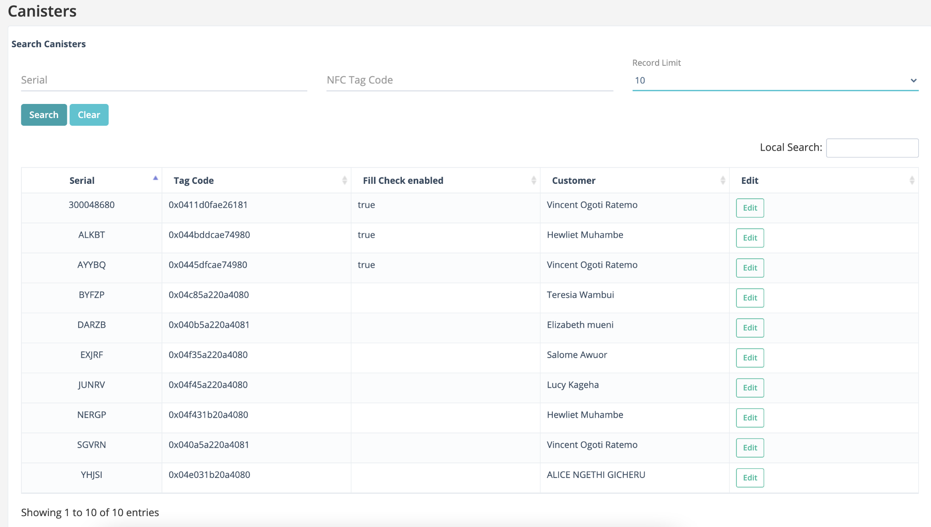
Squad
Works in a confusing way.
As per traditional mental model, works best with a pagination component.
Redundant Search Functionalities
Effort should be put to adhere to mental model of users ( as they use other websites, as well) : Jacob’s Law.

Slide 27
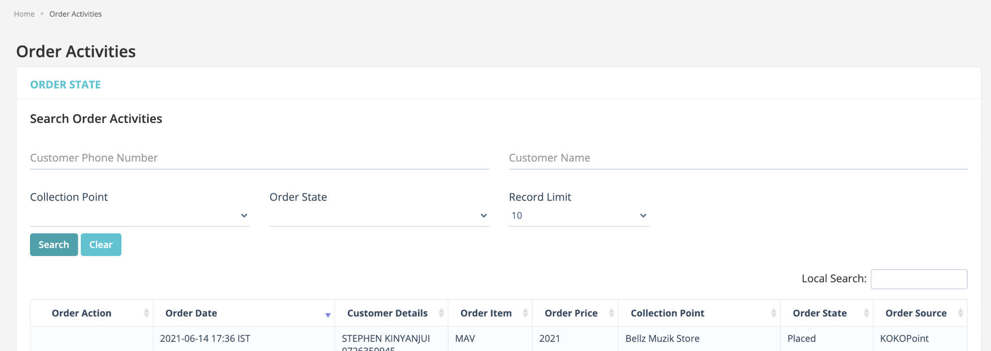
Effects All
Take care per story basis
Multiple Page titles
Try to be as clear as possible to reduce cognitive dissonance.

Slide 28
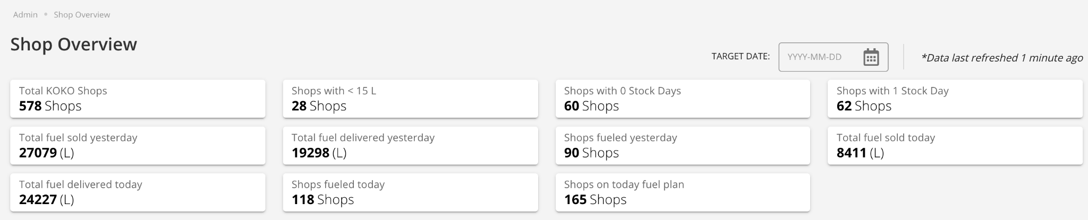
Squad
Redundant “ Shops” to adding to visual clutter
Recommendation
Since the blocks are not clickable, it should have affordance which communicates the same.

Slide 29
Squad
With the long list of data, it feels like the user will end up “Searching”, anyways.
May be make “Search” prominent, in the first place?
Expose information in small chunks which user can receive and process.

Slide 30
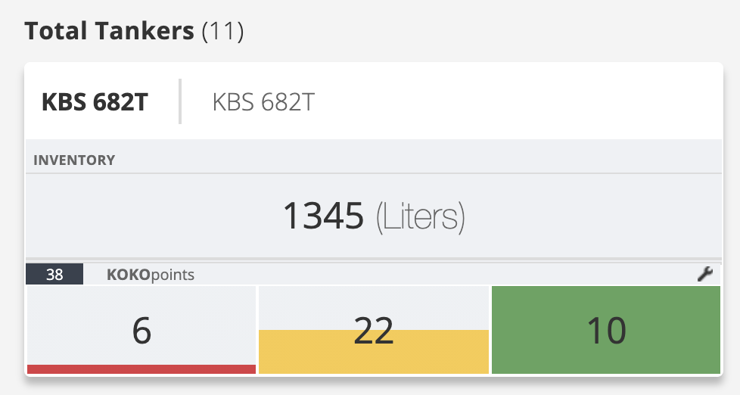
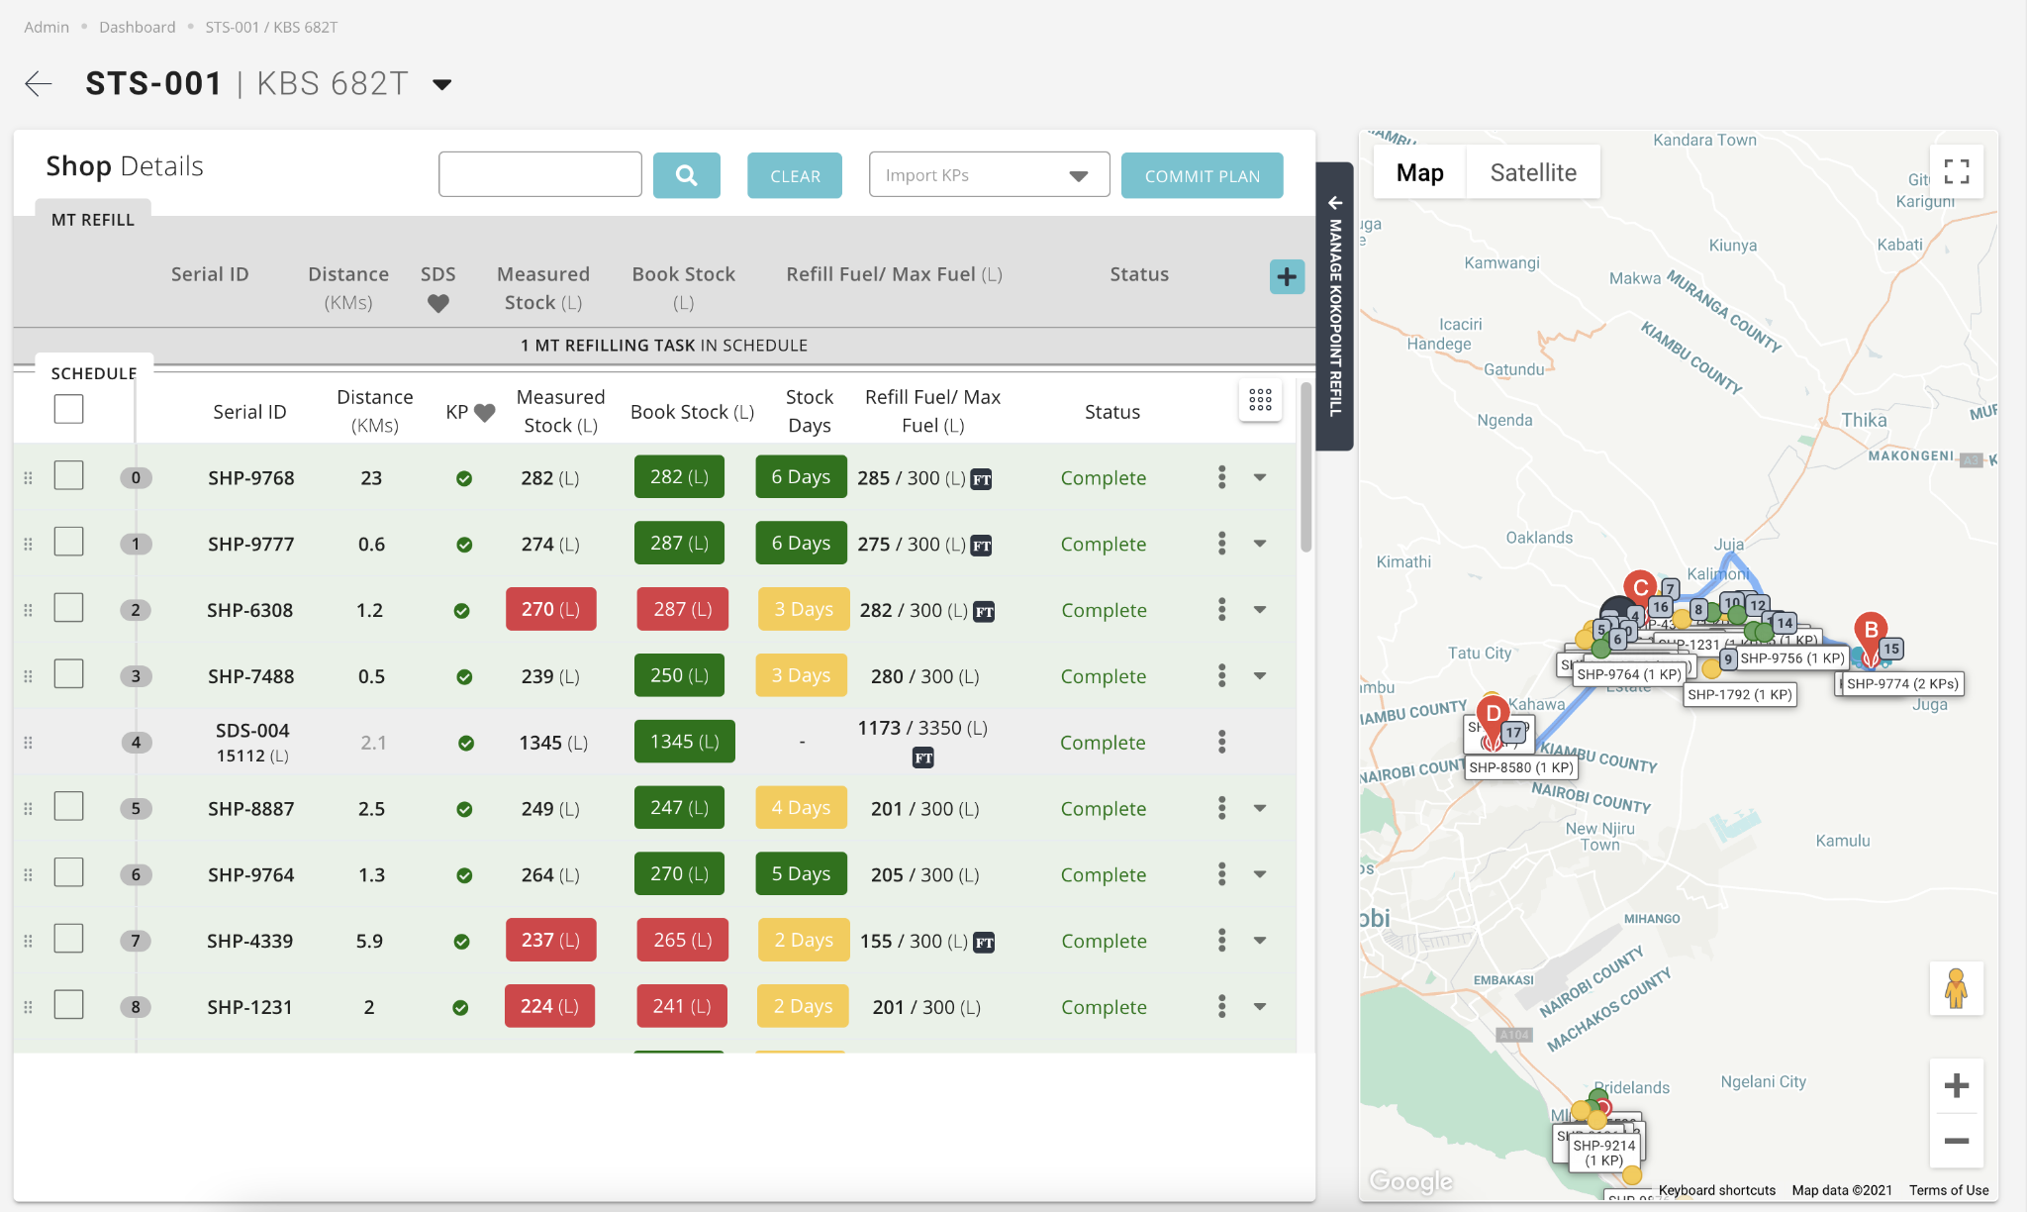
Squad
All 4 hotspots lead to the same screen.
Misleading affordance.
Navigation model of the application should map to the expected mental model of the user.

Slide 31
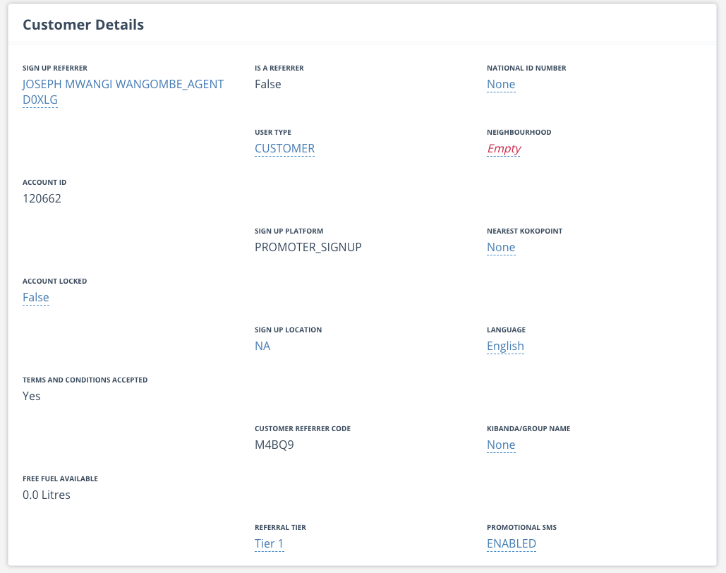
Squad
Taking up too much space.
Misaligned.
Possibly in-efficient clustering of information.
Opportunity to clean this up.
Rightly clustered information helps reduce cognitive and motor load.

Slide 32
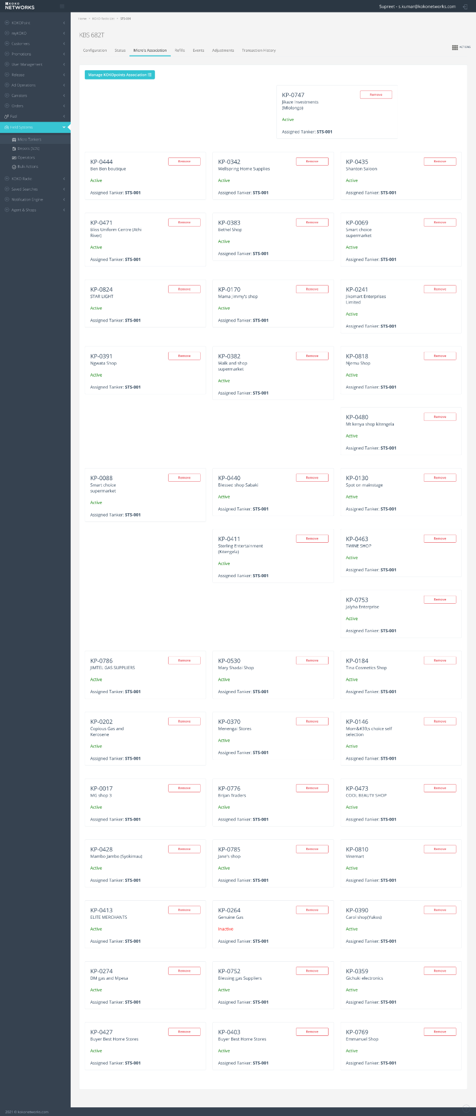
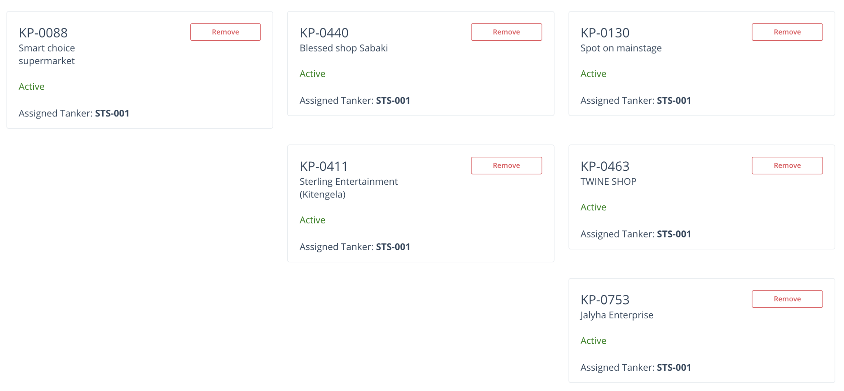
Squad
Criminal wastage of screen space
?
?
?
?
Information should be portrayed in orderly fashion, making best use of screen space

